Slide 1







THANK YOU FOR DOWNLOADING!
In case the embedded fonts don’t work, here are the download links:
VT323
https://fonts.google.com/specimen/VT323
Roboto Condensed
https://fonts.google.com/specimen/Roboto+Condensed
@dstoryco
https://znap.link/dstoryco
This is also a interactive navigation bar that looks like a music player. Copy and paste it to the bottom of your slides:
Simple ver:
5:00
Spotify ver:
GHOSTING
2:00
5:00
TXT
Previous / Next slide
Current slide number
Move the indicator to the right for each slide
Total number of slides
Go to the summary slide

Slide 2





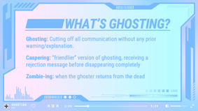
SUMMARY
Notes:
[This is the summary zoom slide. It was made by going to Insert > Zoom > Summary Zoom.]

Slide 3

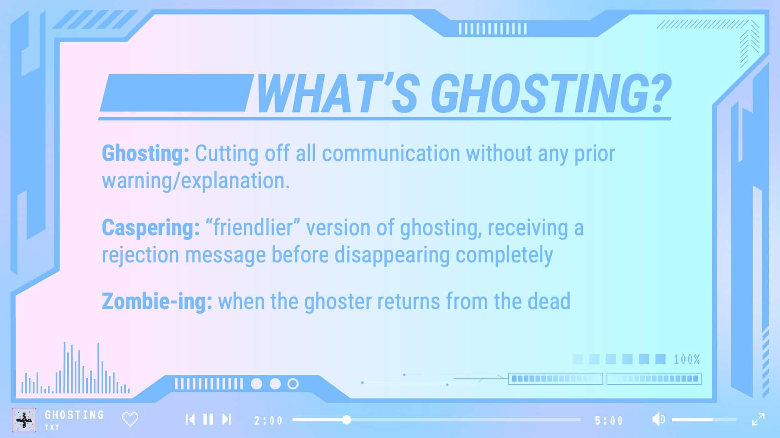
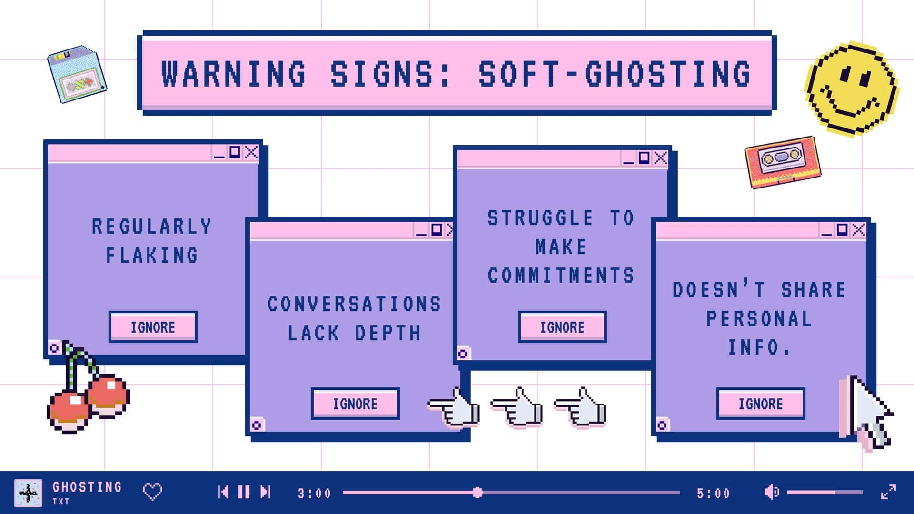
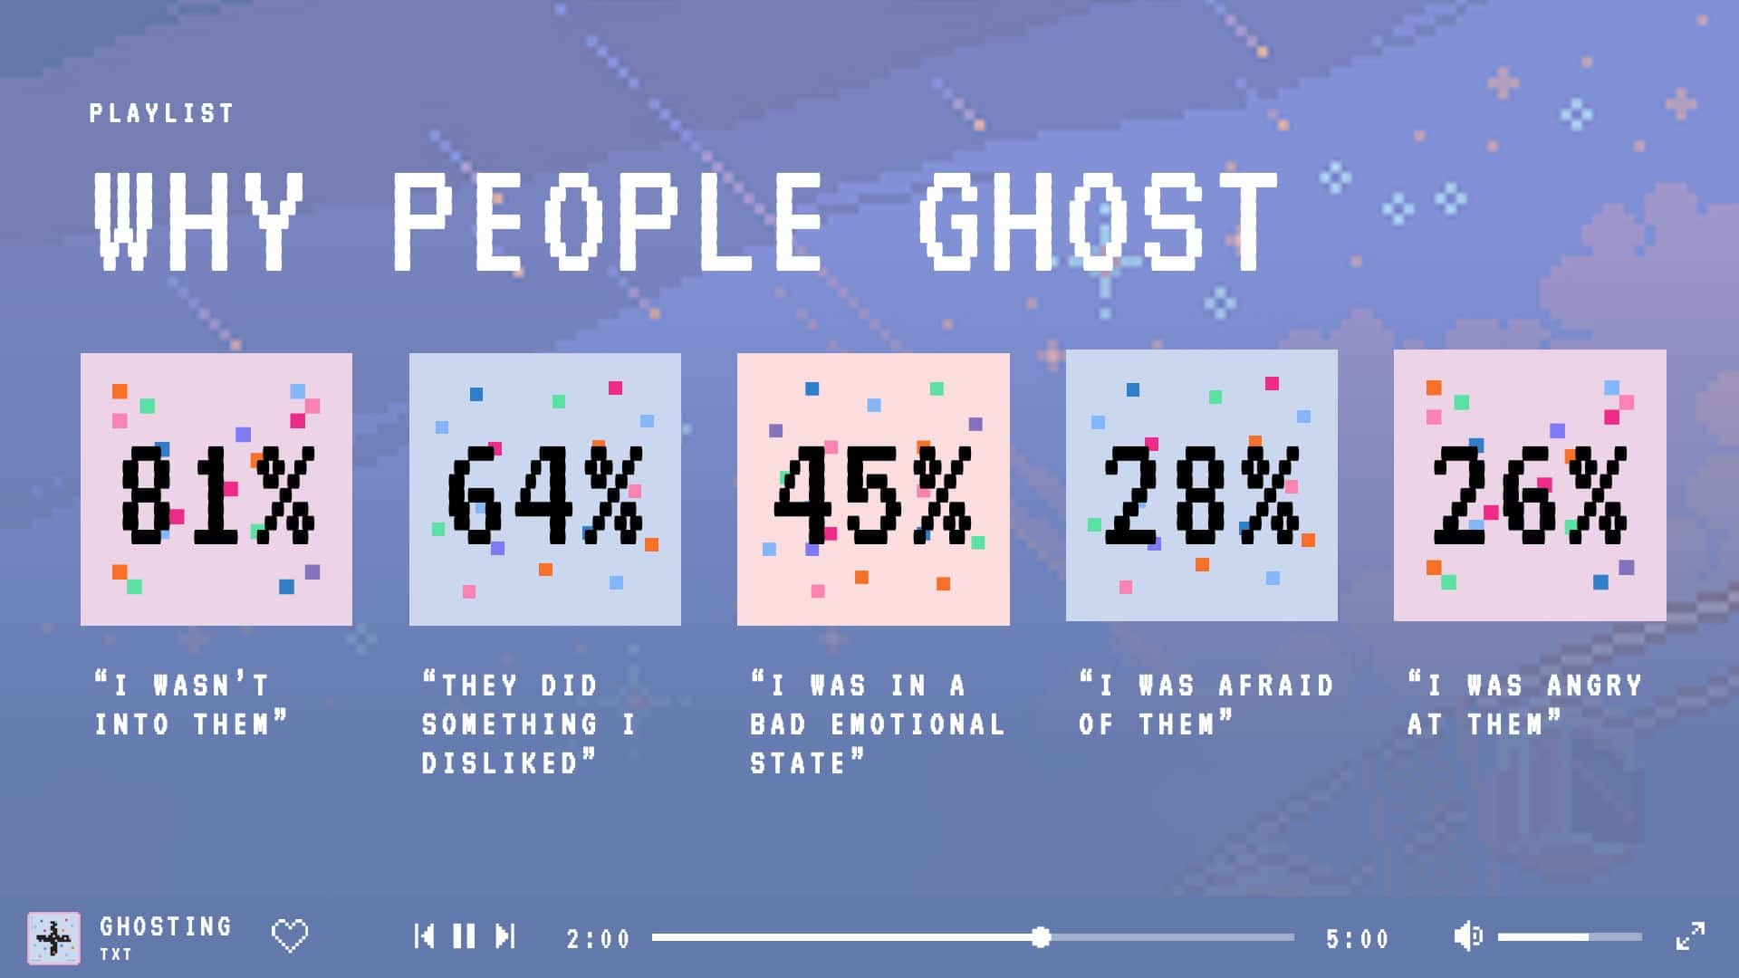
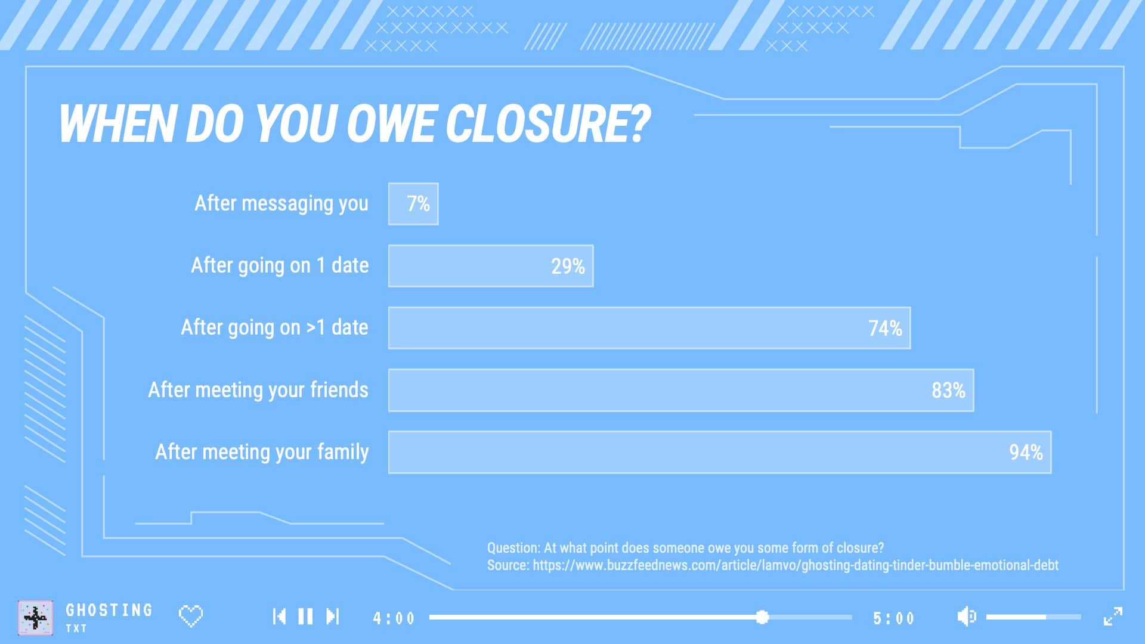
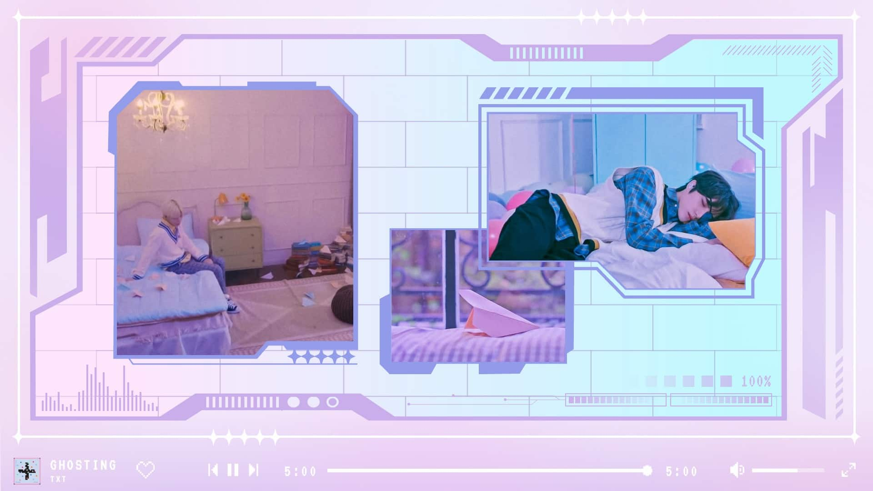
OVERVIEW BACKUP
Notes:
In case the previous slide doesn’t work/you don’t have Slide Zoom on PowerPoint. These are basically images of the slides, with links on them. Right click and click Link so that when you press on the slides, it jumps straight to it.

Slide 4
GHOSTING
TXT Minisode 1: BLUE HOUR themed PowerPoint template
@DSTORYCO

Slide 5







03:04
1
2
ABC
3
DEF
4
GHI
5
JKL
6
MNO
7
PQRS
8
TUV
9
WXYZ
0

Slide 6
WHAT’S GHOSTING?
Ghosting: Cutting off all communication without any prior warning/explanation.
Caspering: “friendlier” version of ghosting, receiving a rejection message before disappearing completely
Zombie-ing: when the ghoster returns from the dead
GHOSTING
1:00
5:00
TXT

Slide 7













WARNING SIGNS: SOFT-GHOSTING
REGULARLY FLAKING
STRUGGLE TO MAKE COMMITMENTS
CONVERSATIONS LACK DEPTH
DOESN’T SHARE PERSONAL INFO.
IGNORE
IGNORE
IGNORE
IGNORE
GHOSTING
2:00
5:00
TXT

Slide 8


WHY PEOPLE GHOST
PLAYLIST
81%
64%
45%
28%
26%
“I WASN’T INTO THEM”
“THEY DID SOMETHING I DISLIKED”
“I WAS IN A BAD EMOTIONAL STATE”
“I WAS AFRAID OF THEM”
“I WAS ANGRY AT THEM”
GHOSTING
3:00
5:00
TXT

Slide 9
WHEN DO YOU OWE CLOSURE?
Question: At what point does someone owe you some form of closure? Source: https://www.buzzfeednews.com/article/lamvo/ghosting-dating-tinder-bumble-emotional-debt
GHOSTING
4:00
5:00
TXT

Slide 10


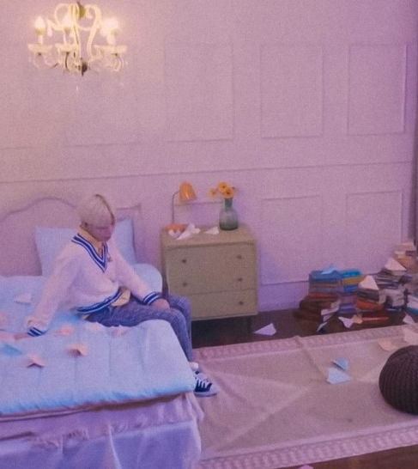
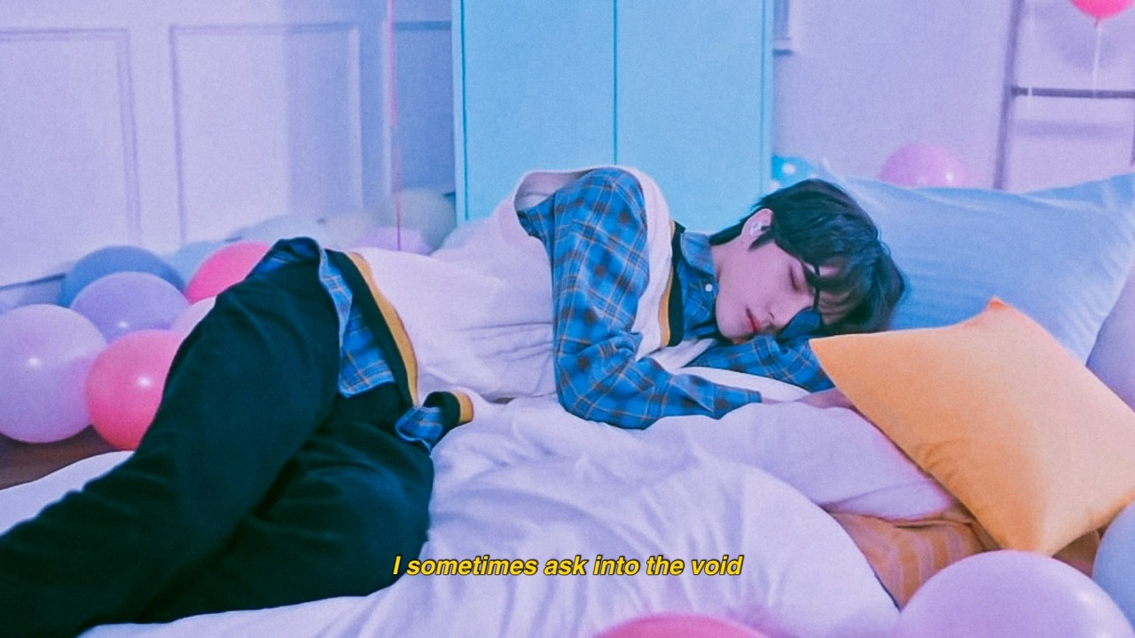

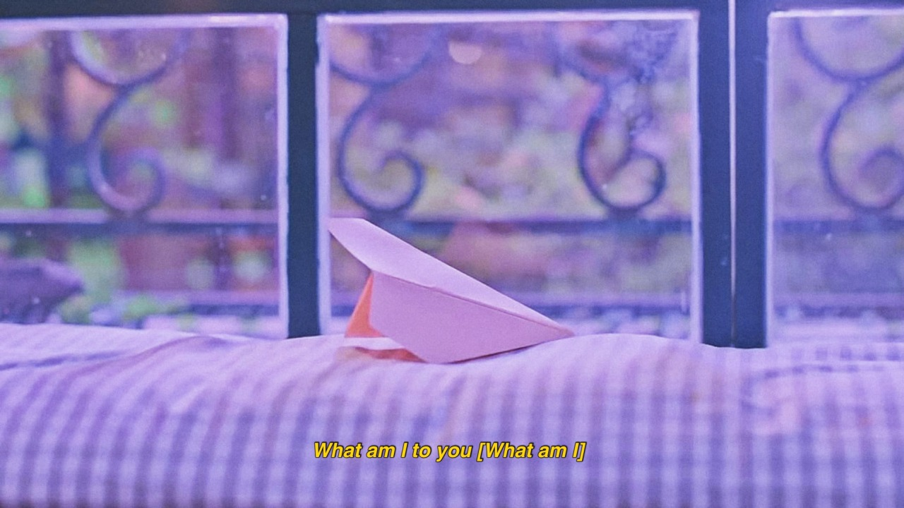
GHOSTING
5:00
5:00
TXT
Notes:
[To update the photos, right click on them and click “Change Picture”]

